Slide 1

Residential Septic System Repair & Replacement Program
Heather Nielsen
Conservation Investments Coordinator

Slide 2
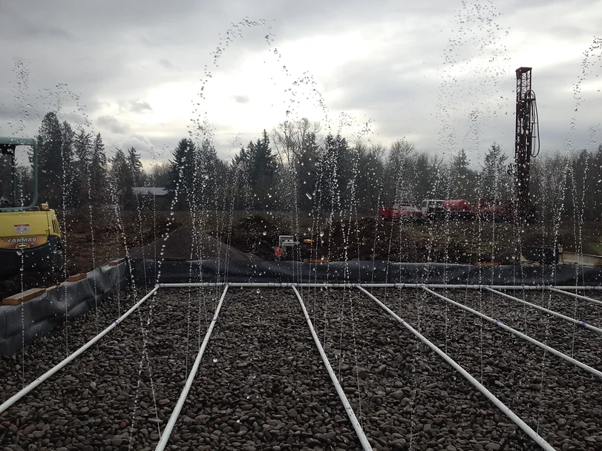
Why did Clackamas SWCD set up a Loan Program
  Serves the public by improving water quality and health conditions.
  Helps homeowners invest in conservation.
  Projects get done sooner.
  Both the public and homeowners benefit.
Notes:
Talk about source funding up here

Slide 3
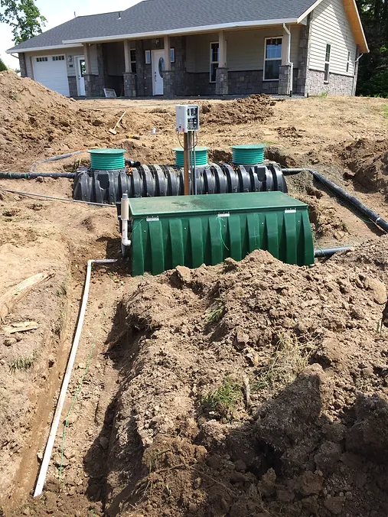
CSWCD and CWSRF
  First loan in 2008 for water quality improvement projects.
  Expanded in 2016 by adding septic repair.
  Septic repair started in the Clackamas River Basin, quickly expanded.
  Now serves all of Clackamas County and septic repair loans are the primary use of the CWSRF loan.

Slide 4
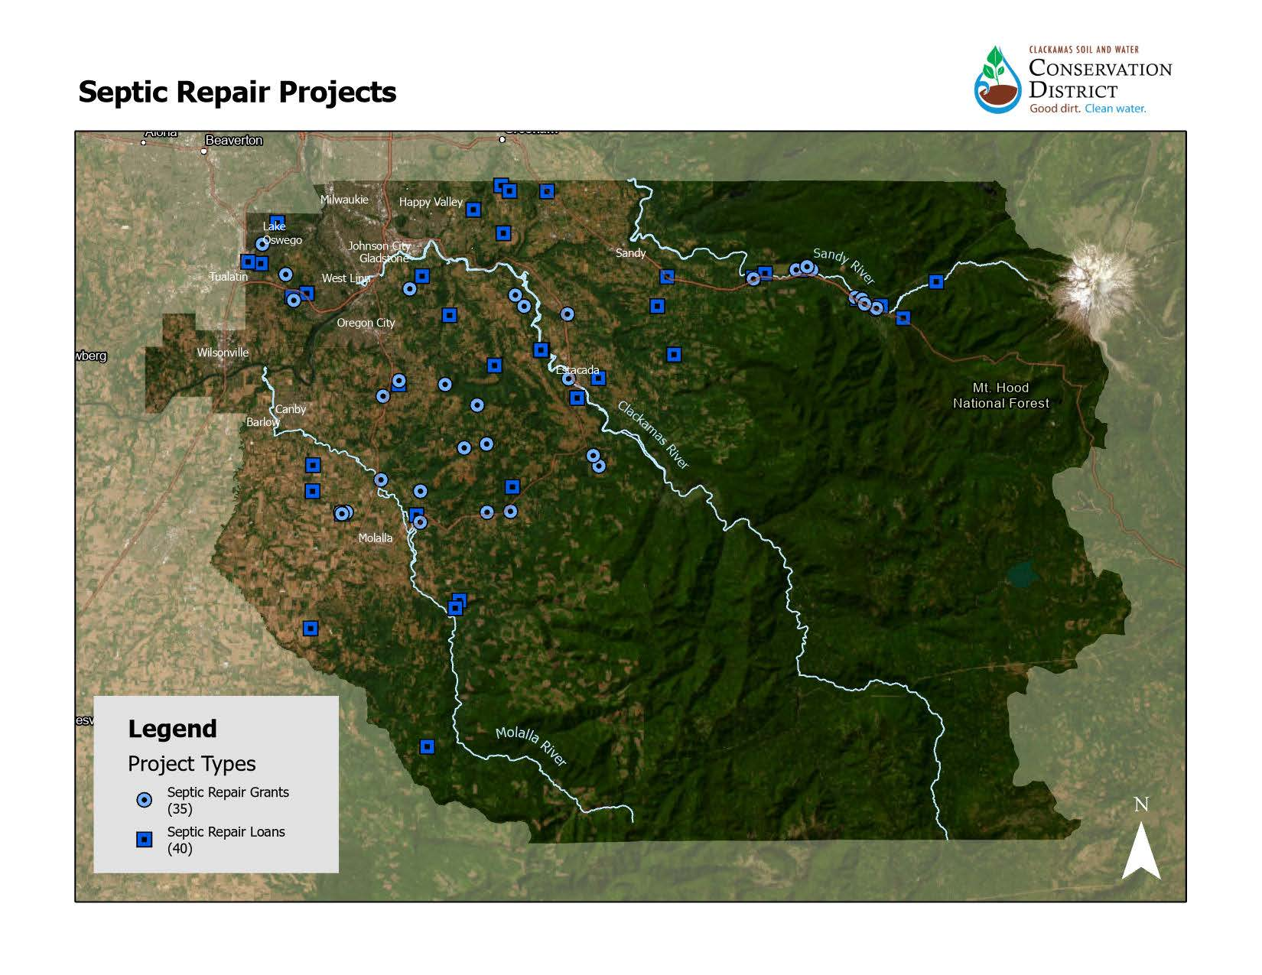

Slide 5
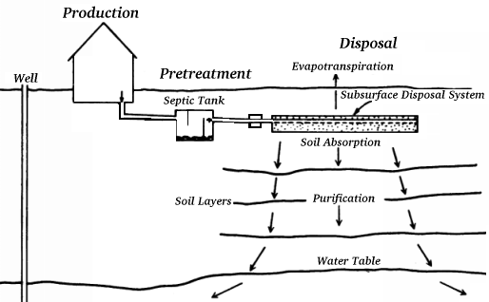
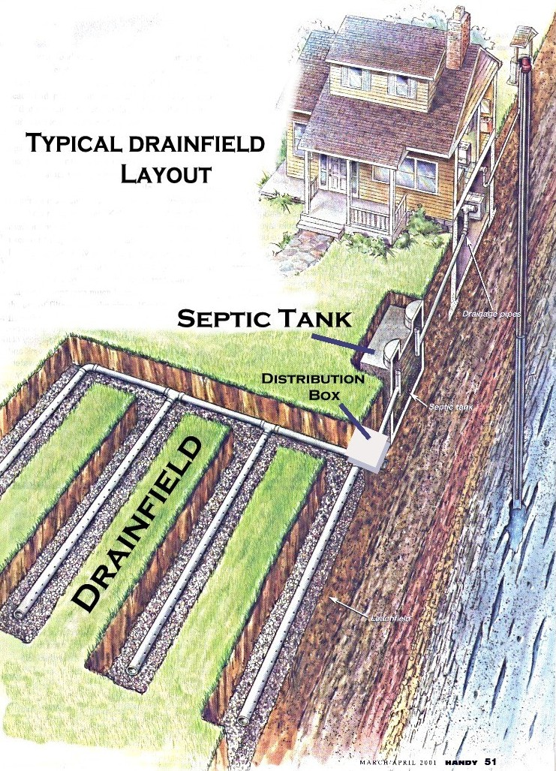
Septic System Basics

Slide 6
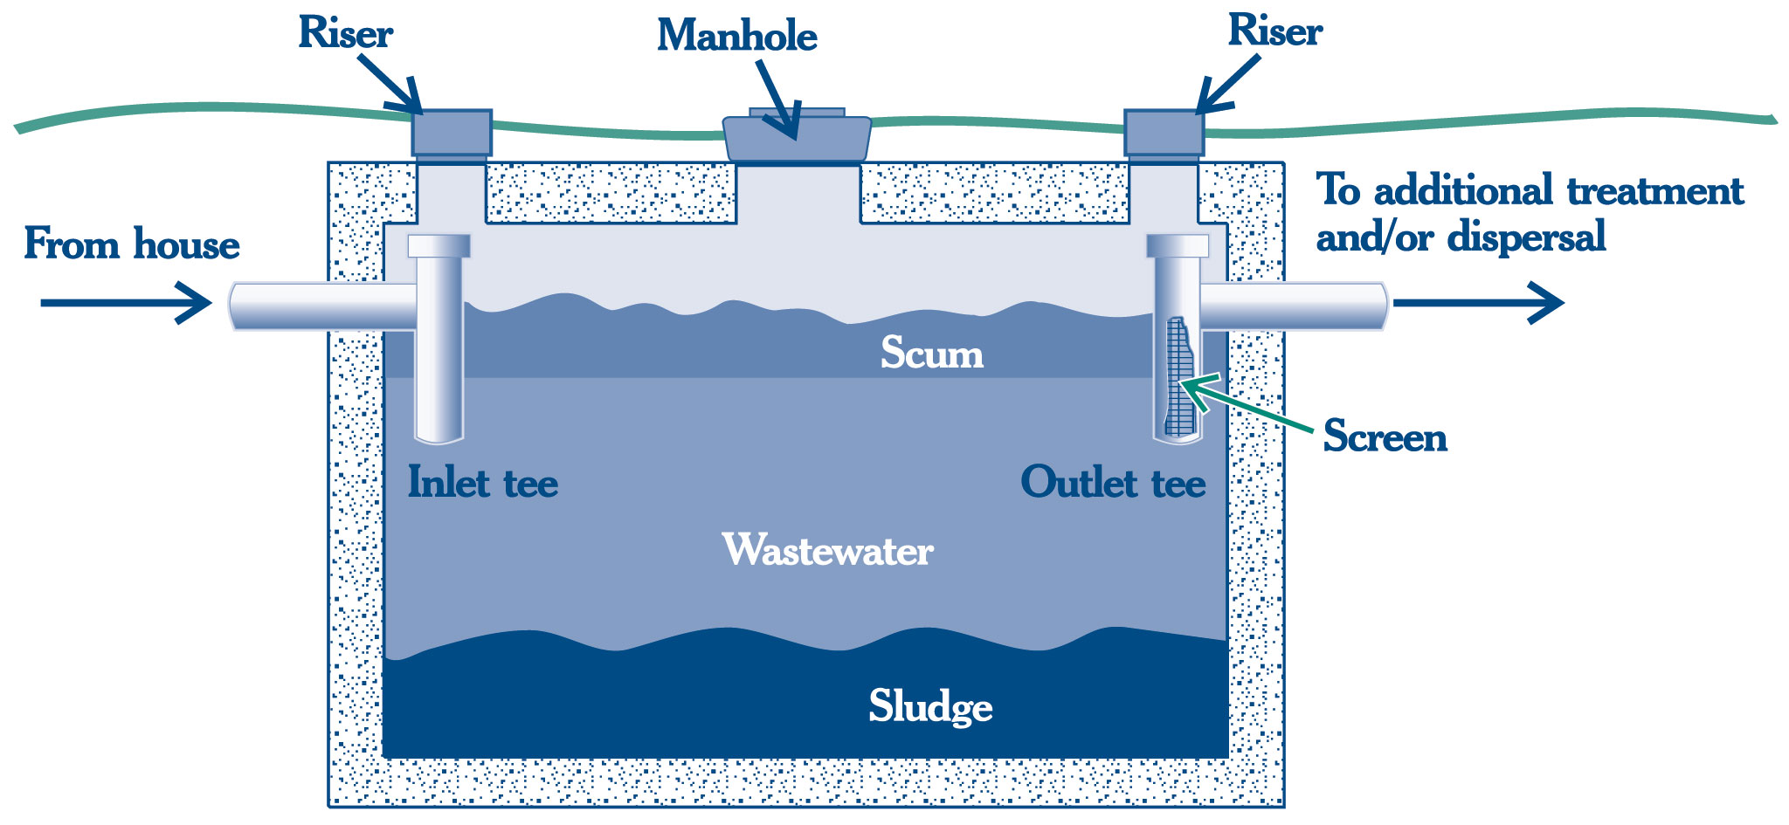
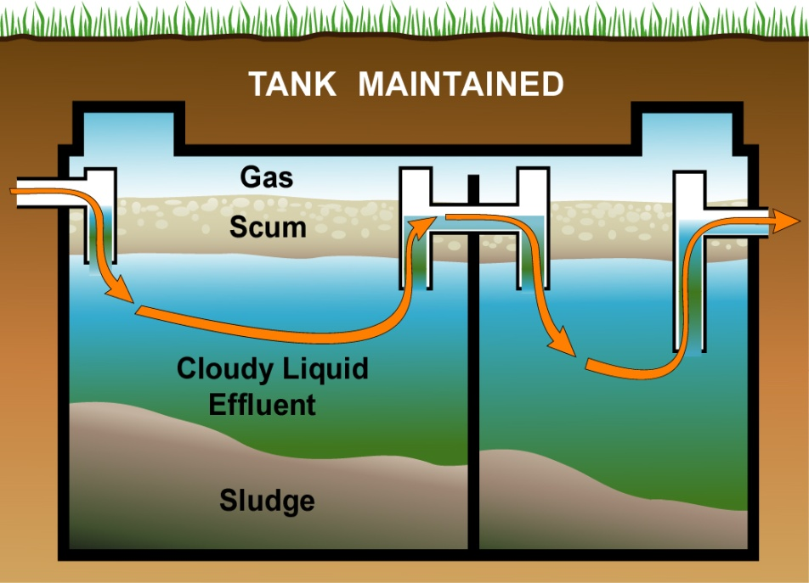
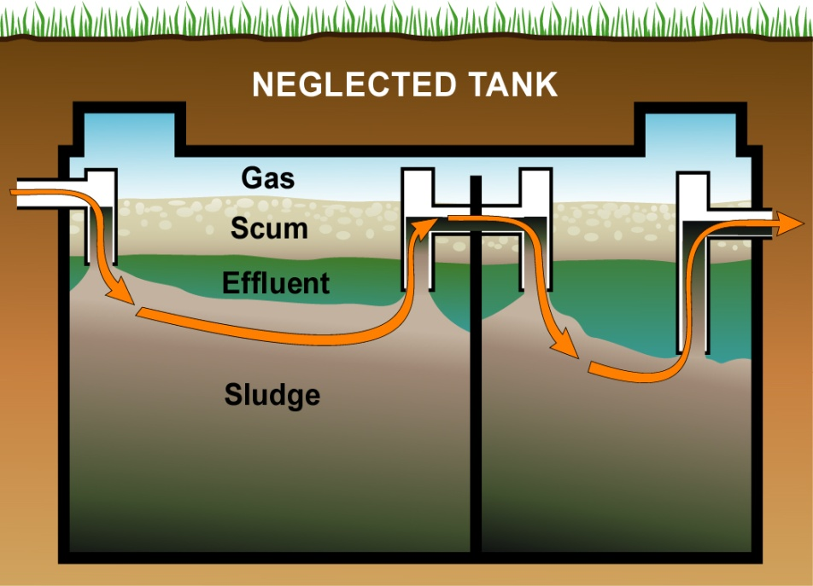
Septic Tank

Slide 7
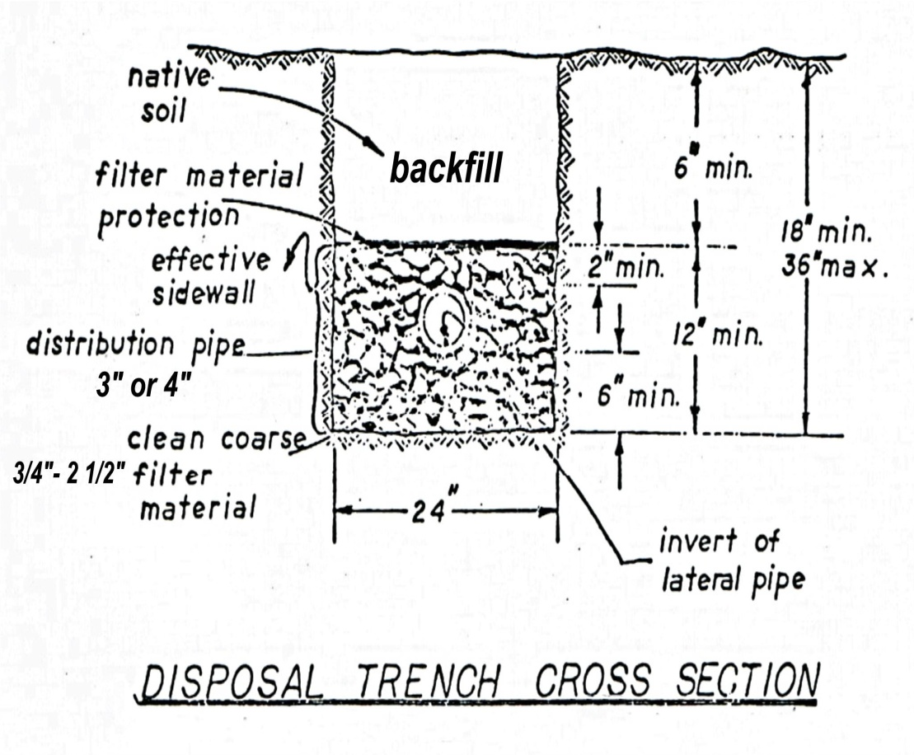
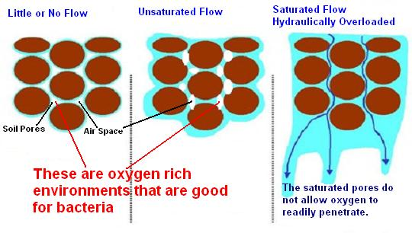
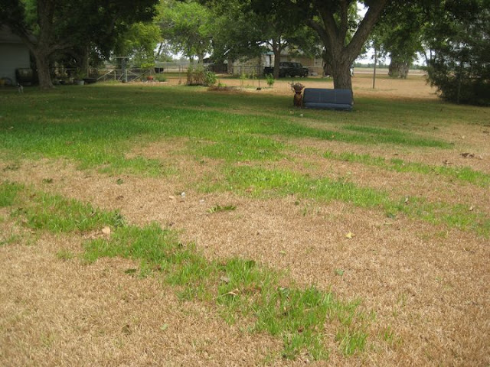
Drainfield

Slide 8
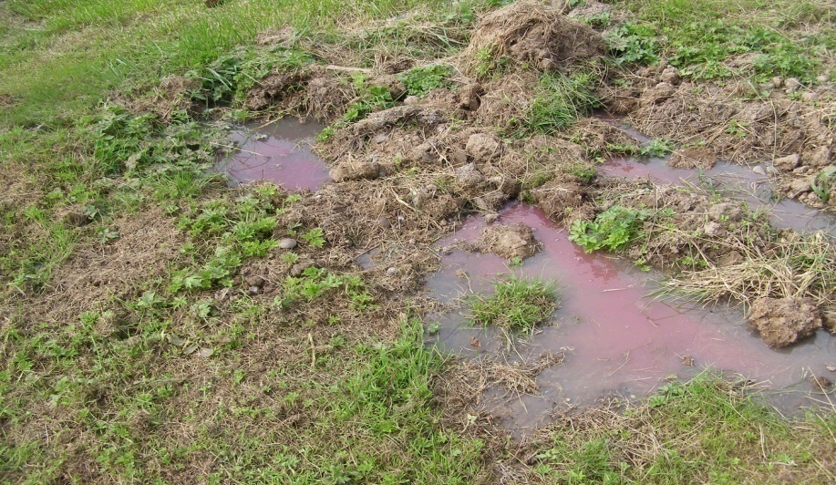
Contaminants of Concern in Sewage
  Pathogens-bacteria & viruses
  Nutrients-Nitrogen & Phosphorous
    Nitrate is of particular concern for water quality
  Residual chemicals/toxics/pharmaceuticals
    Whatever goes down the drain becomes sewage

Slide 9
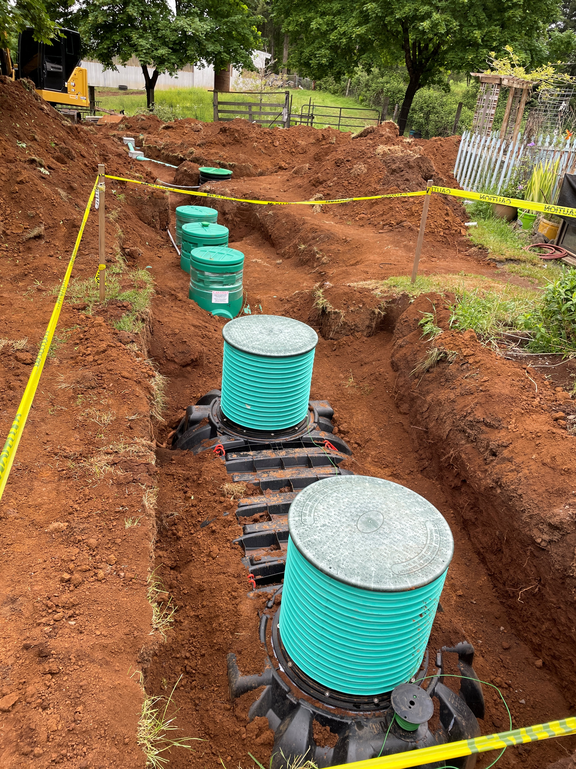
The Importance of Septic System Operations and Maintenance
Protect your investment
  New systems cost $8,000 - $50,000
  Septic systems have life spans
  Regular O & M can extend the life
Protect your health and that of the environment
  Sewage contains numerous disease causing organisms
  Animals can carry and spread these organisms

Slide 10
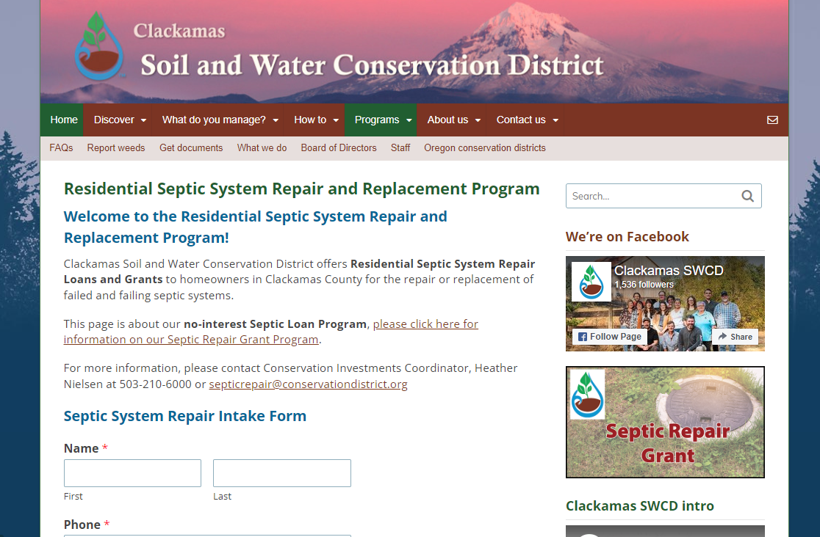
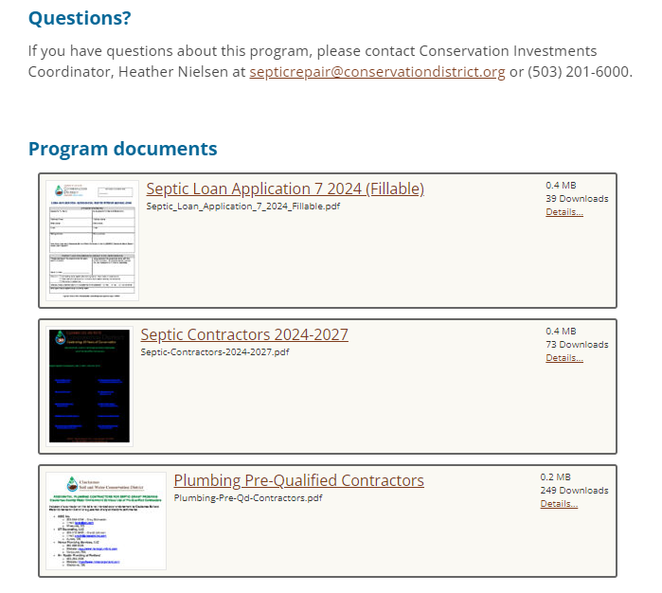
CSWCD’s Internal Process
Application
Grant/Loan Agreement
Completed Permit
Lien / UCC Filing (loans only)
Payment to Contractor
Reporting to DEQ
Draw down of Funds from DEQ

Slide 11
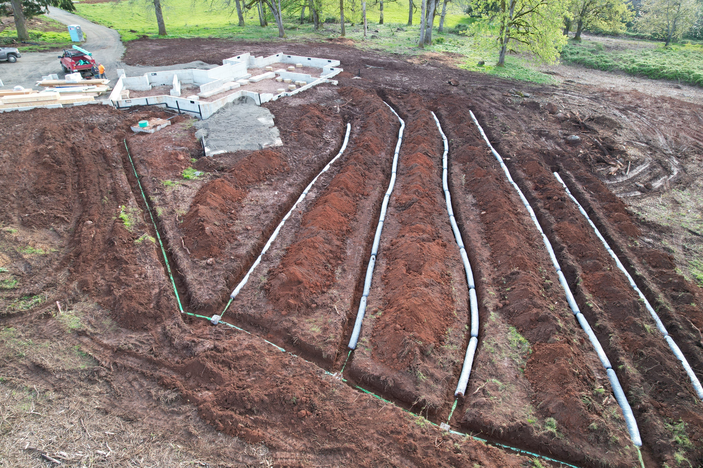
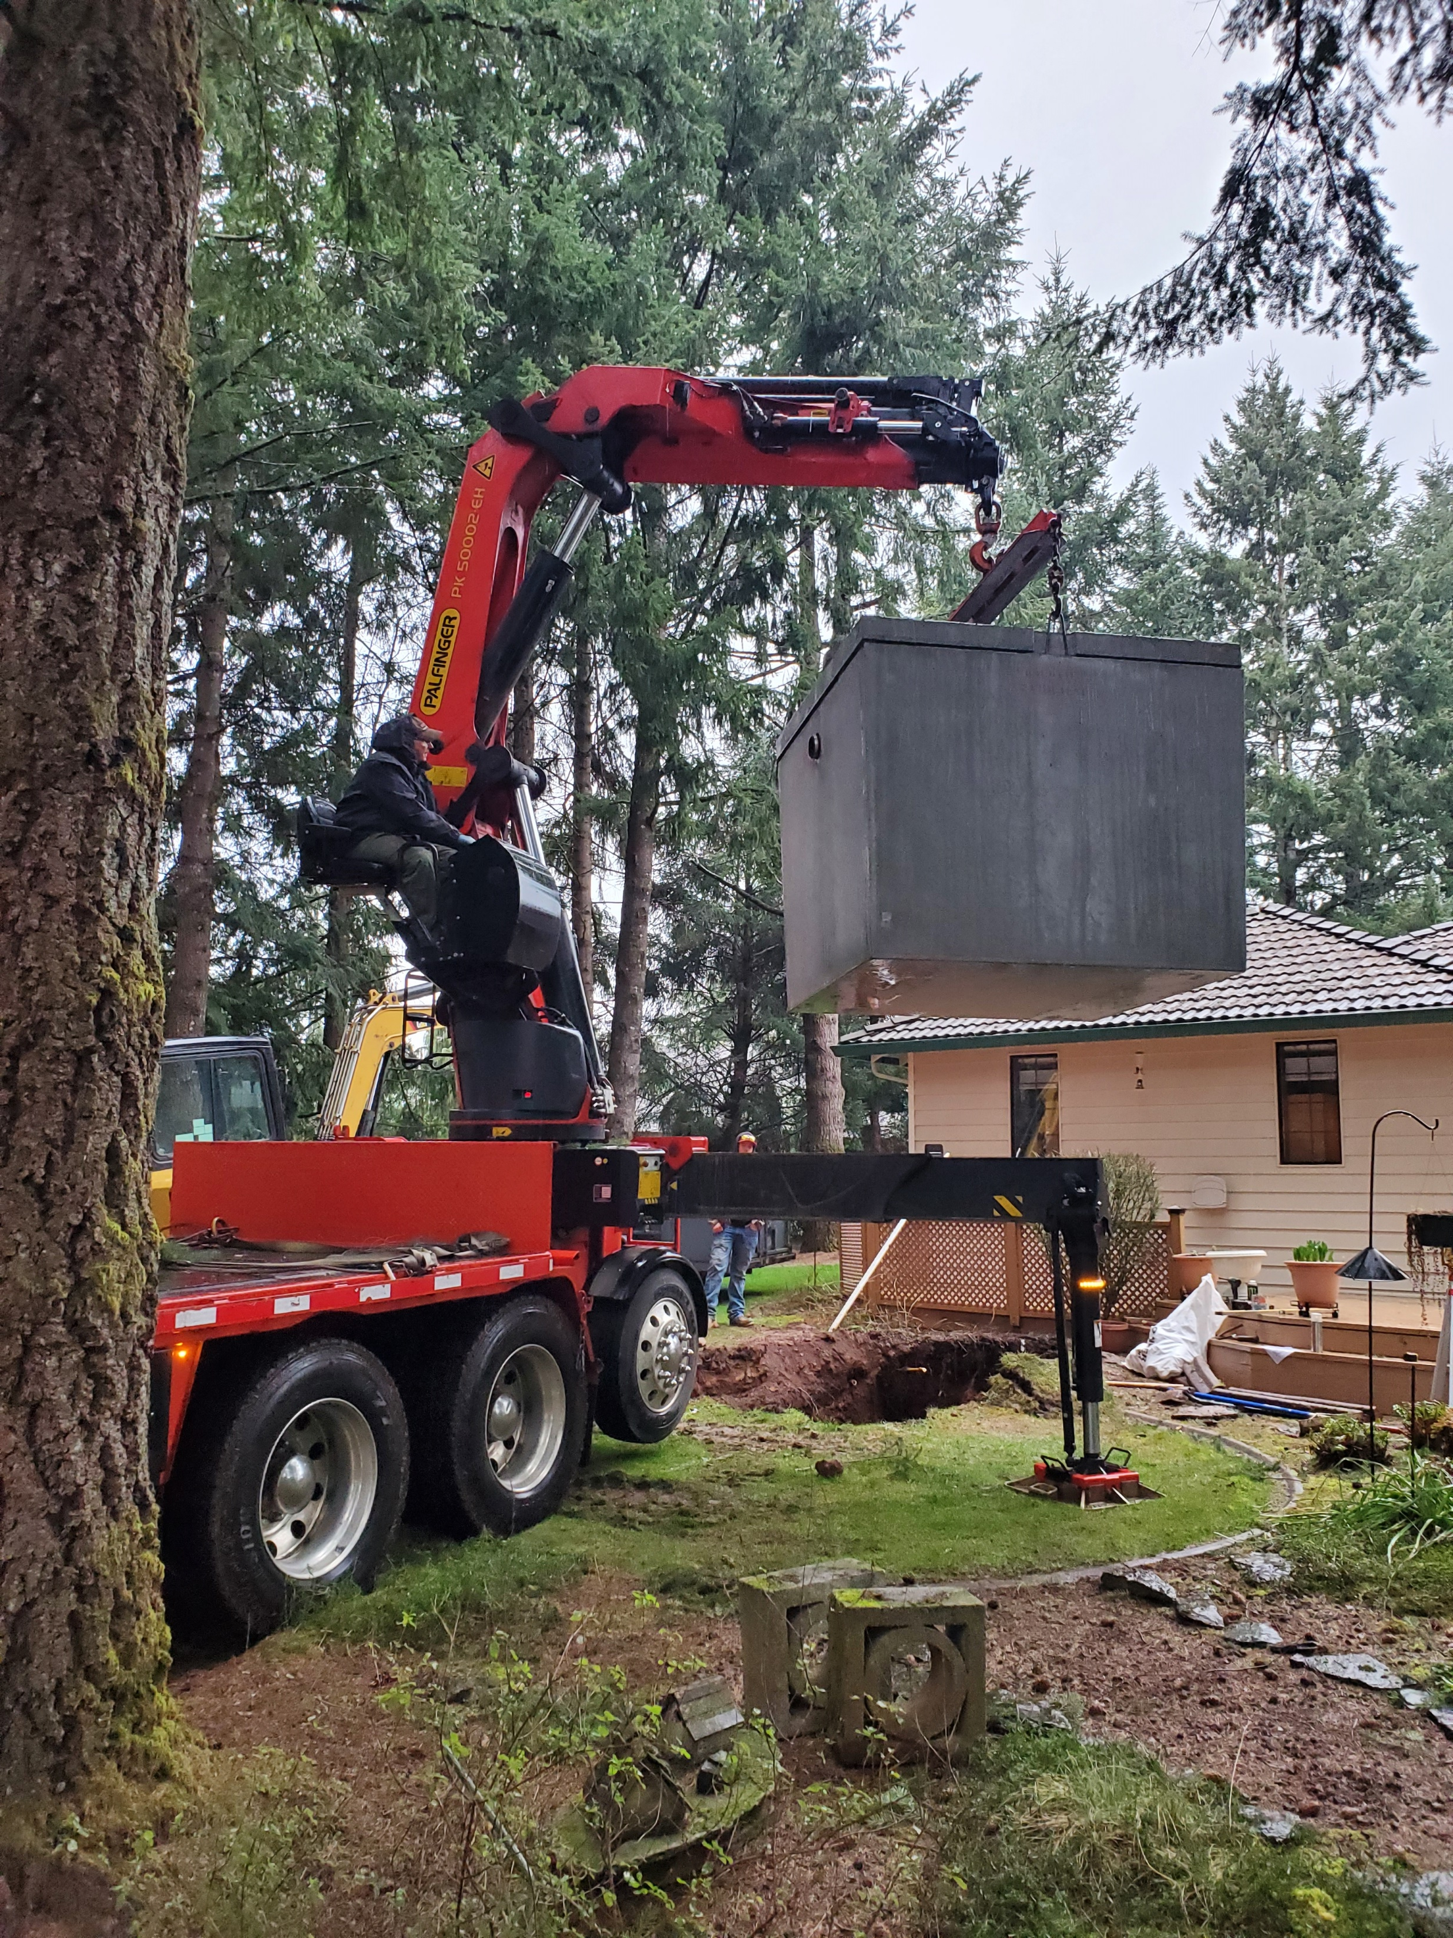
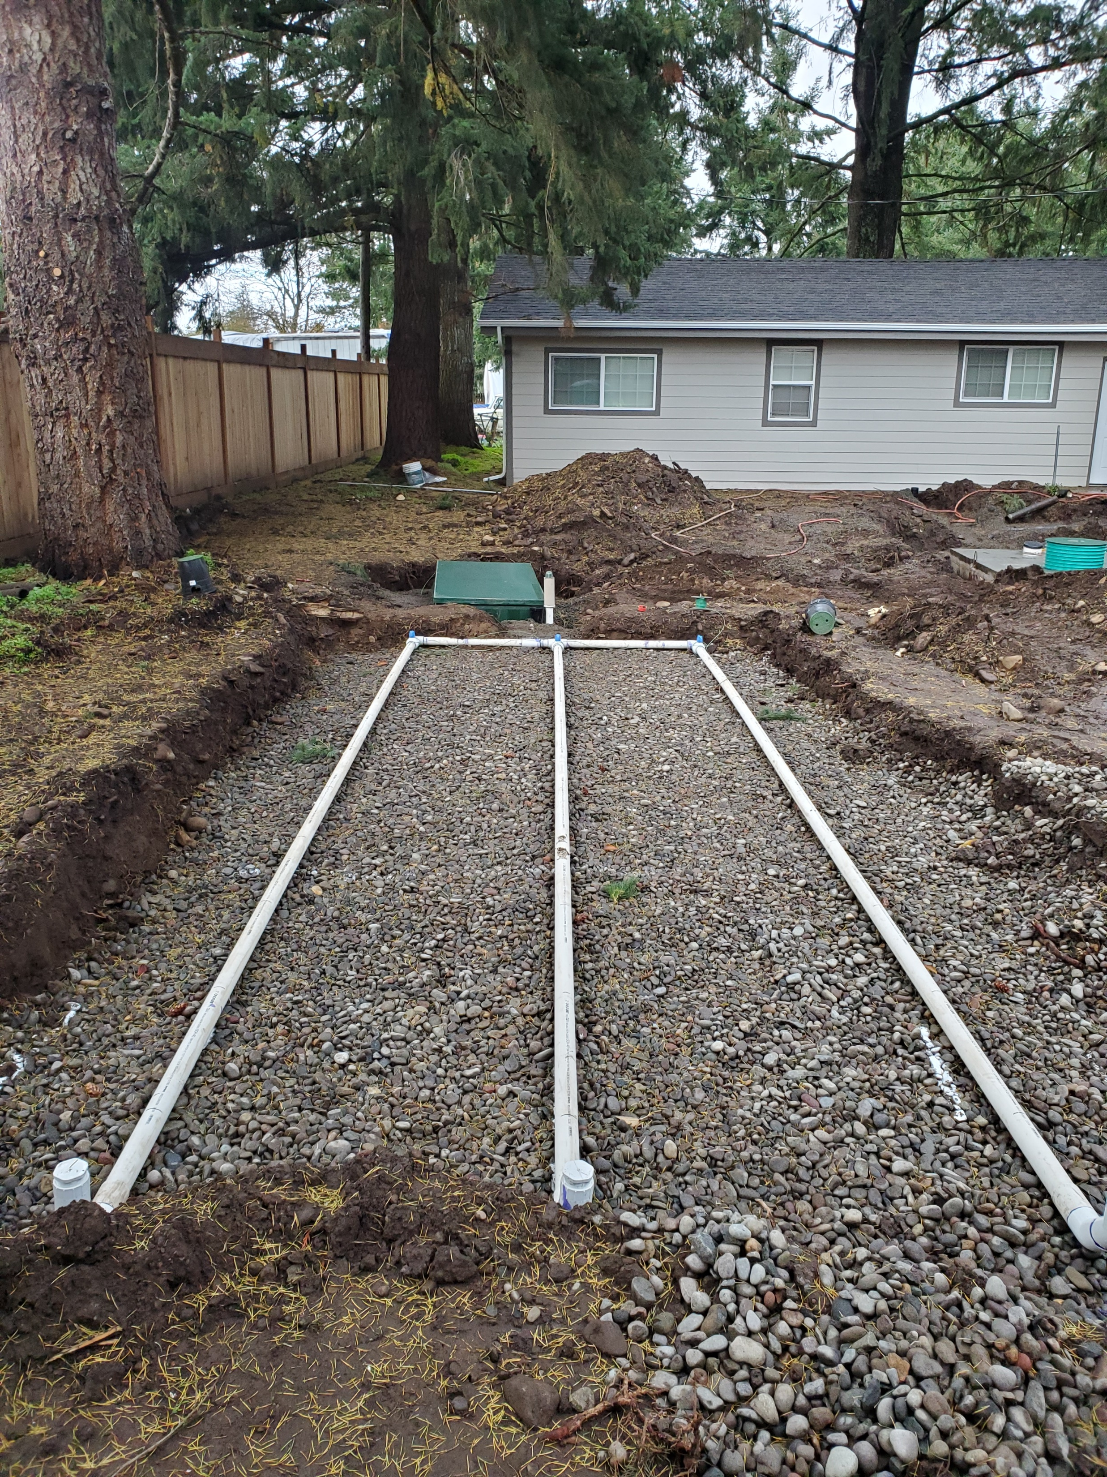
installation

Slide 13
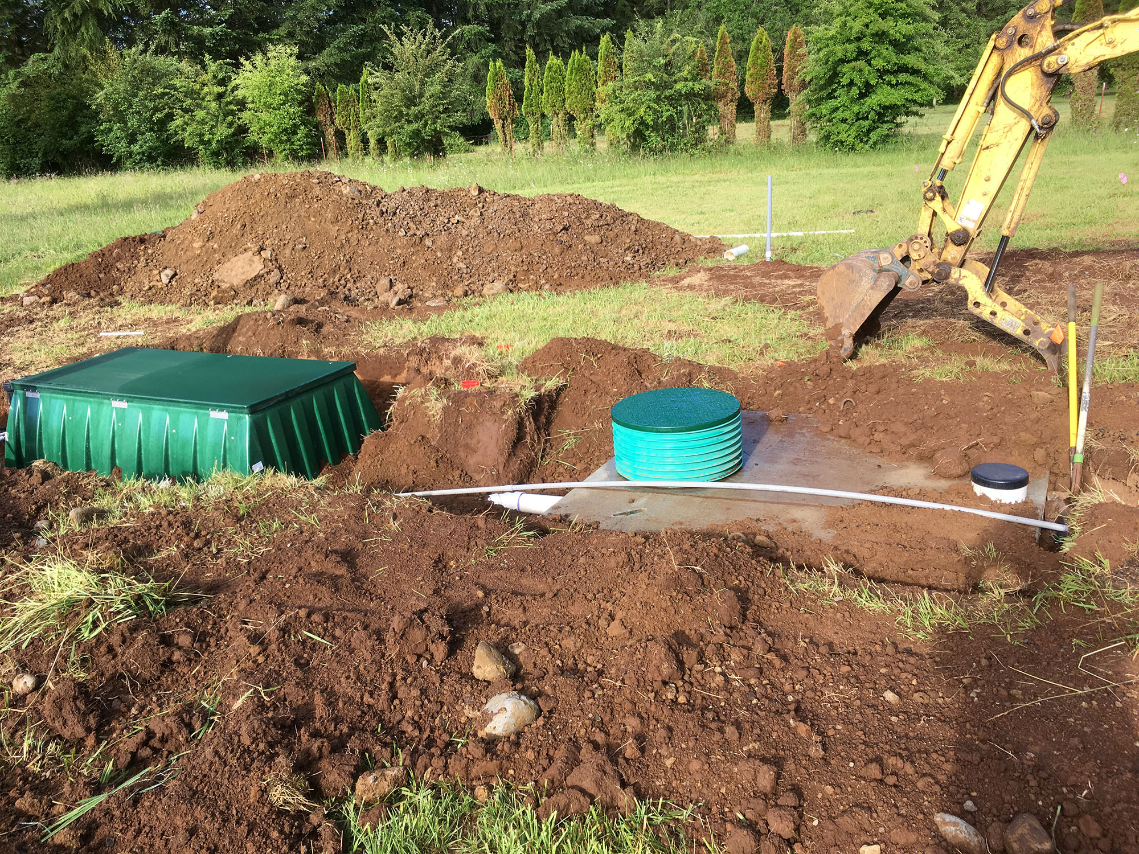
CSWCD’s Required Reporting
Award Amount
Location
Date of Project Completion
Contractor Bid and Invoices
Project Accounting Report
Quarterly Reporting
Annual Reporting
Reporting Needed

Slide 14

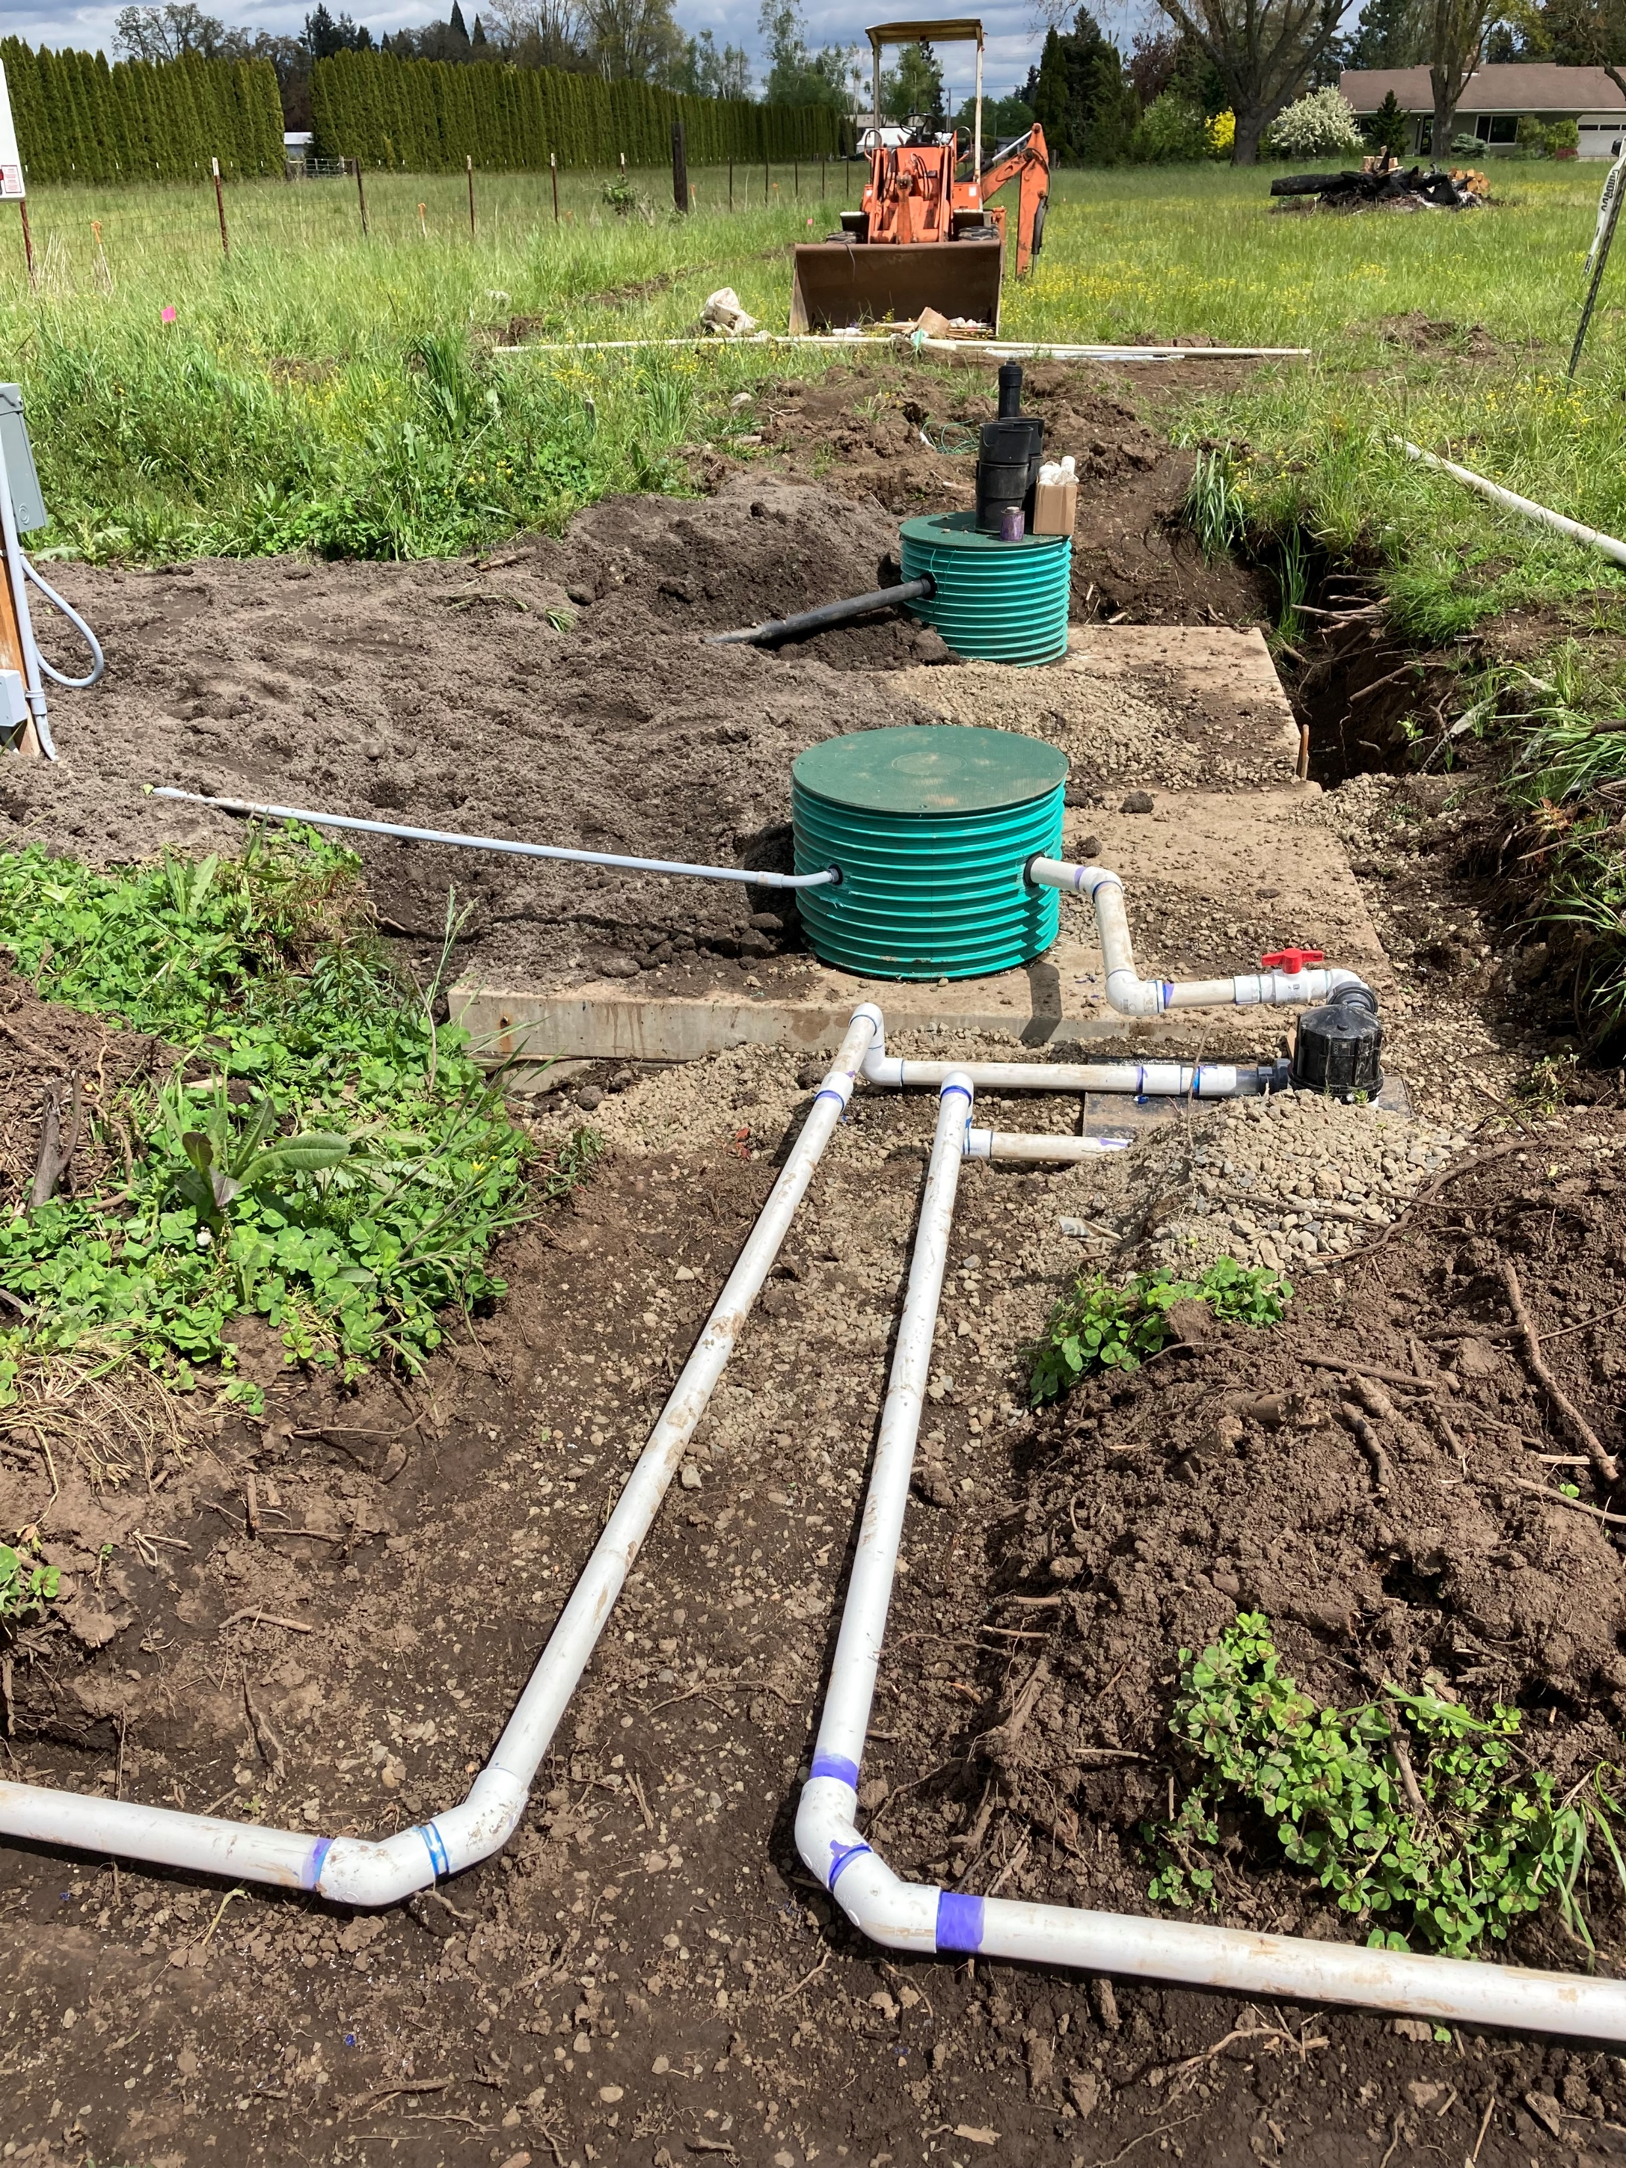
DEQ Onsite financial aid program
The DEQ Onsite Financial Aid Program supports programs to improve public health and water quality by providing grants and low-cost loans to address failing septic systems.
OSFAP utilized $15 million in federal American Rescue Plan Act funds that the 2021 Oregon legislature allocated to DEQ. The legislature also prioritized the use of these funds for 2020 wildfire recovery.
9 organizations across the State received funding
  4 Wildfire specific
  5 General Septic Repair

Slide 15
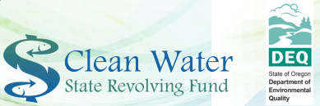
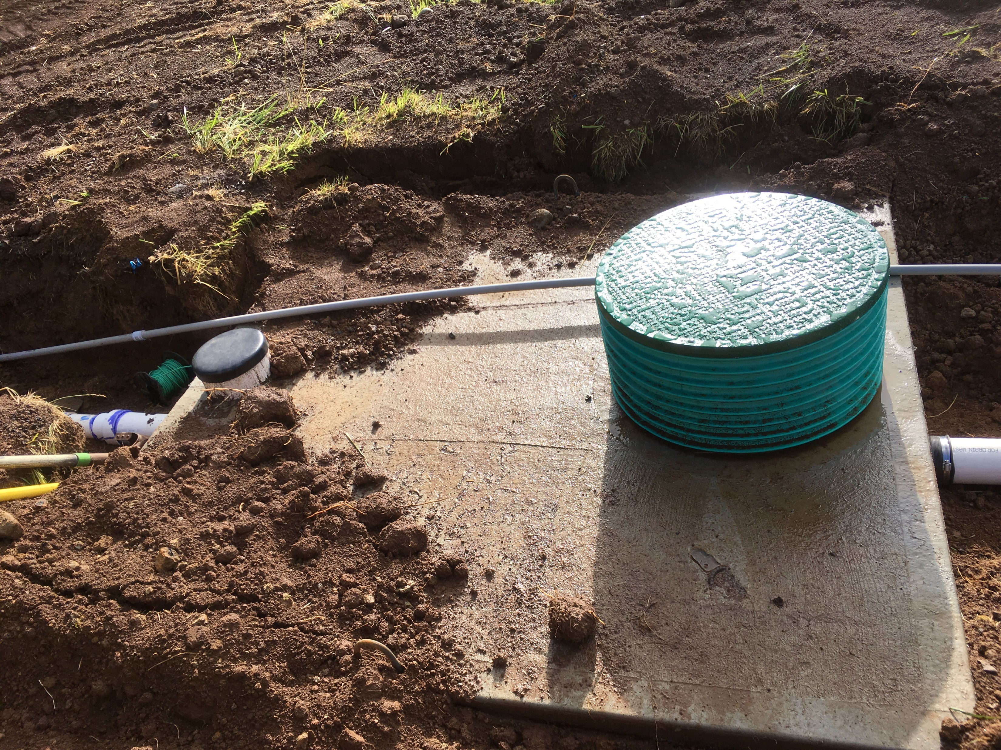
DEQ Cleanwater State
Revolving Fund
Below-market rate loans for planning, design and construction to help protect public health, restore natural areas and promotes economic development.
As money is paid back into the state's revolving loan fund, DEQ makes new loans to other recipients for high priority, water
quality activities allowing the funds to "revolve" at the state
level over time.
Categories: Point Source, Non-Point Source, Planning, and
Local Community
Principle Forgiveness – up to 50% (ADD FACTORS -IUP)

Slide 16
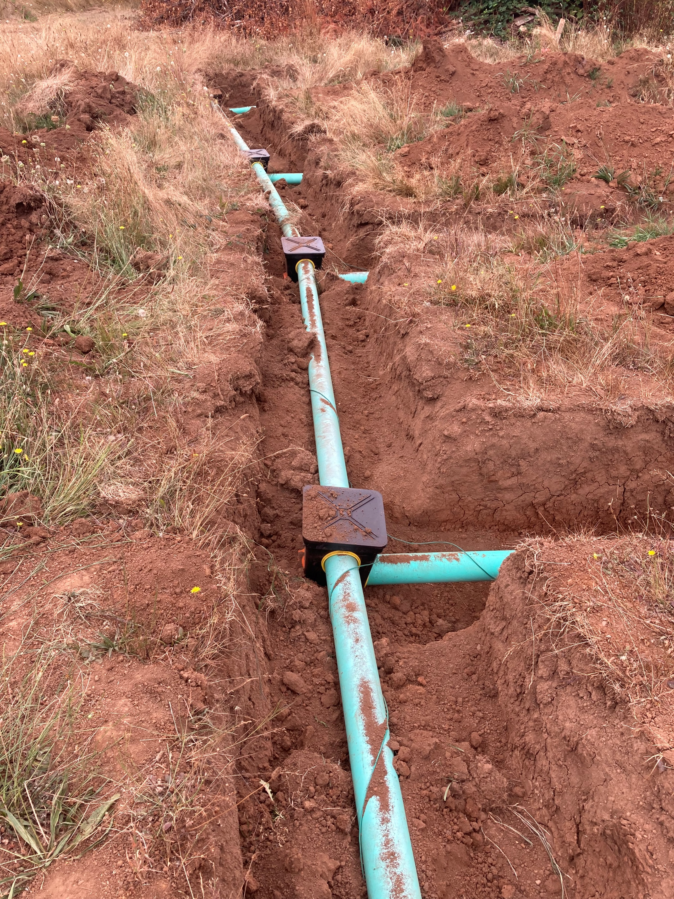
The CleanWater State Revolving Fund Application Process
Three application cycles per year
Unique applications for each loan type (point source, non-point source, planning, local community, and community development)
Long agreement preparation
Notes:
We applied in April
We are still in contracting – we are allowed to spend funds back to our application submittal date

Slide 17
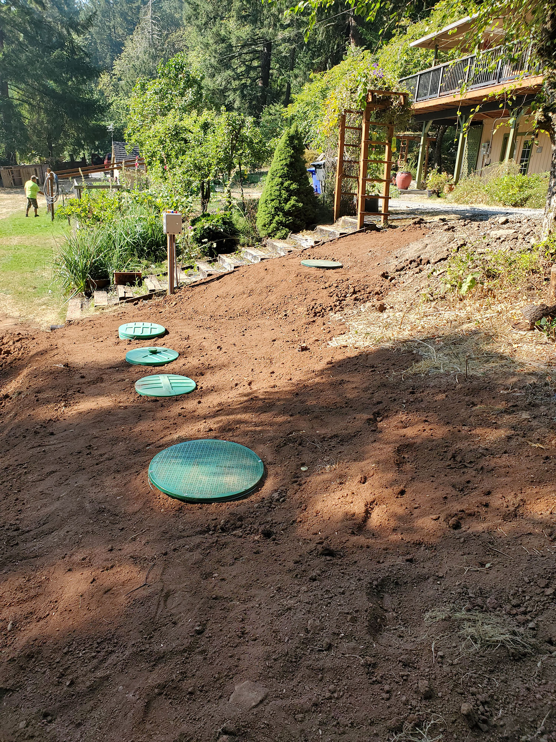
Cleanwater State Revolving Fund Repayment
Reporting and payment requests throughout the active loan
DEQ approves and provides disbursements
The loan closes
DEQ may award loan forgiveness
Borrower begins repayment – up to 10 years

Slide 18
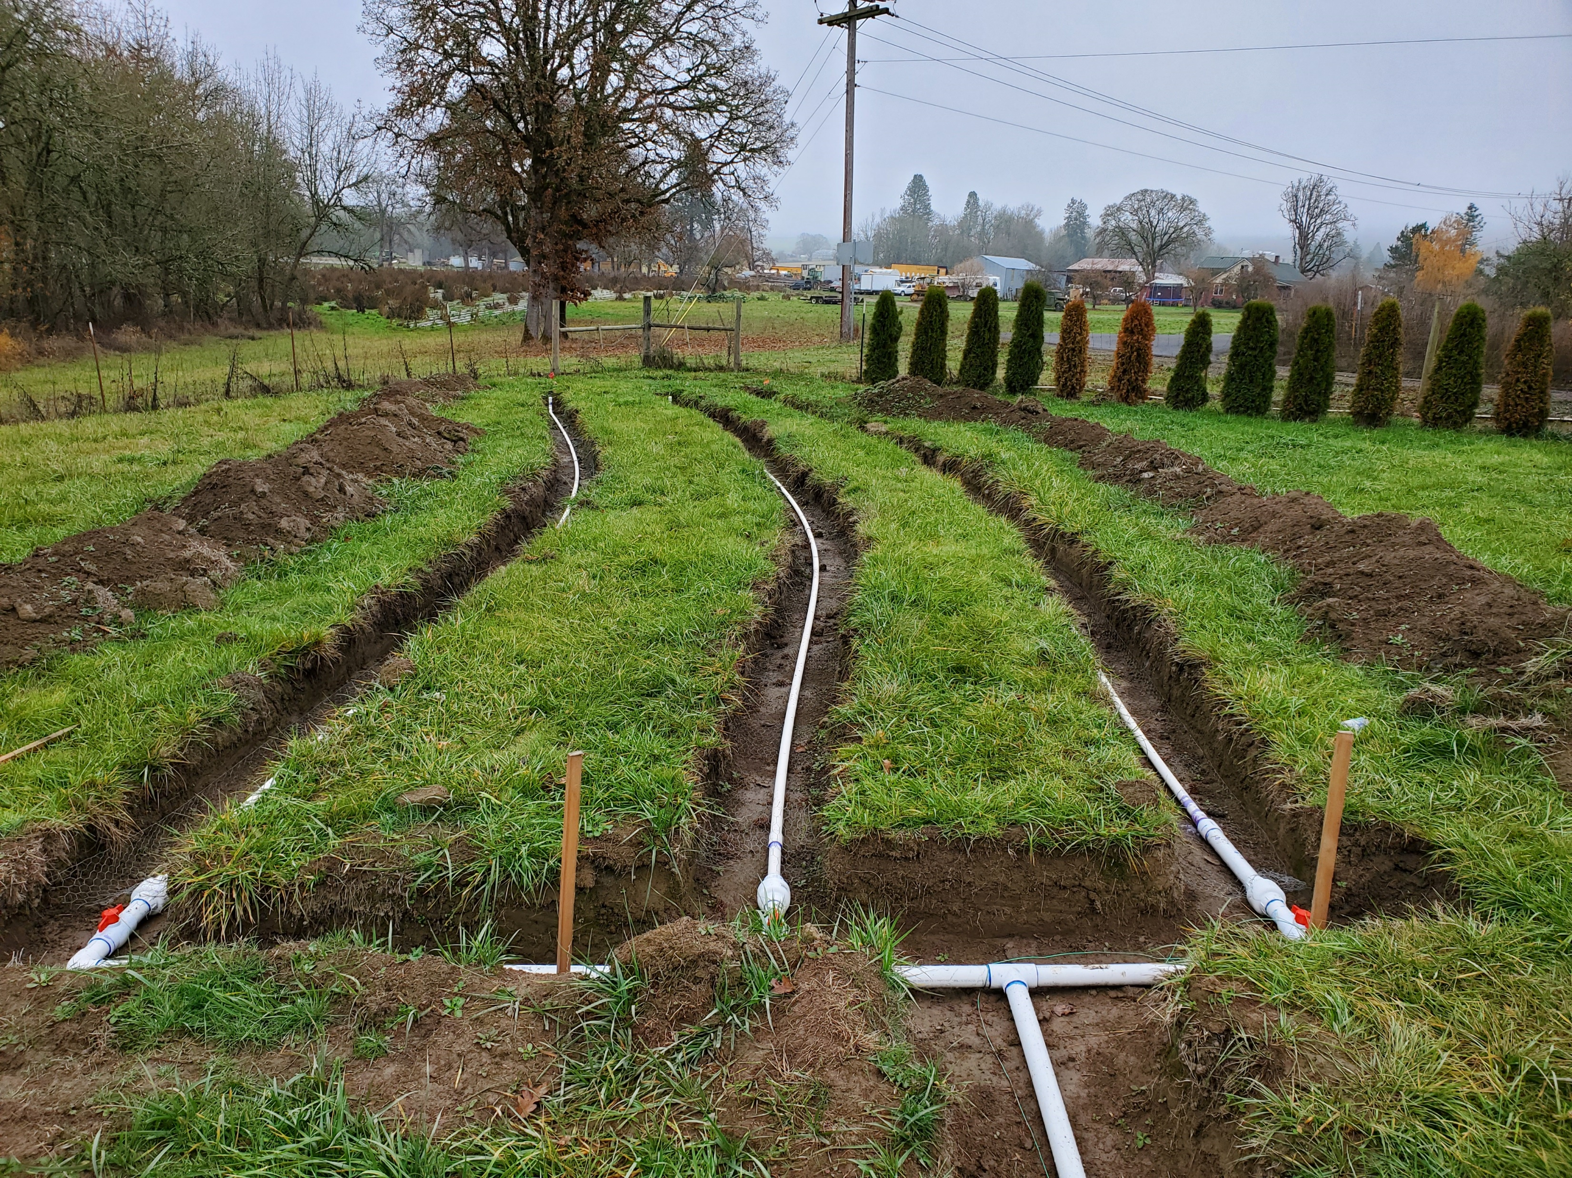
QUESTIONS
Heather Nielsen, RG, WWS
Conservation Investments Coordinator
Office: 503.210.6005
Cell: 971.825.2478
hnielsen@conservationdistrict.org

